Slide 1
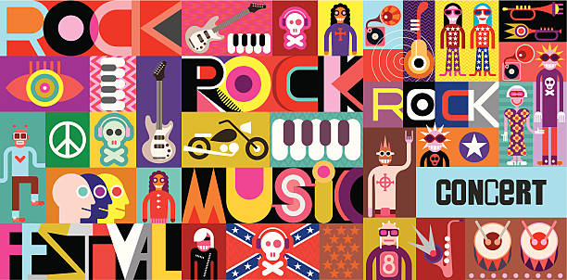
Pop Bands
Artist / Band | Week Beginning
Spice Girls | 01.06.26.
N Sync | 08.06.26.
Backstreet Boys | 15.06.26.
Westlife | 22.06.26.
Take That | 29.06.26.
Destiny’s Child | 06.07.26.
Girls Aloud | 13.07.26.
Term 3.2.

Slide 2
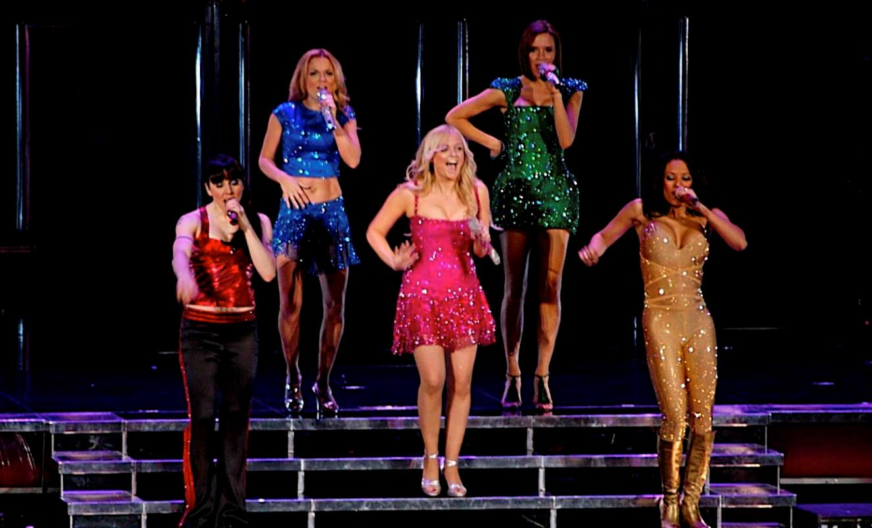
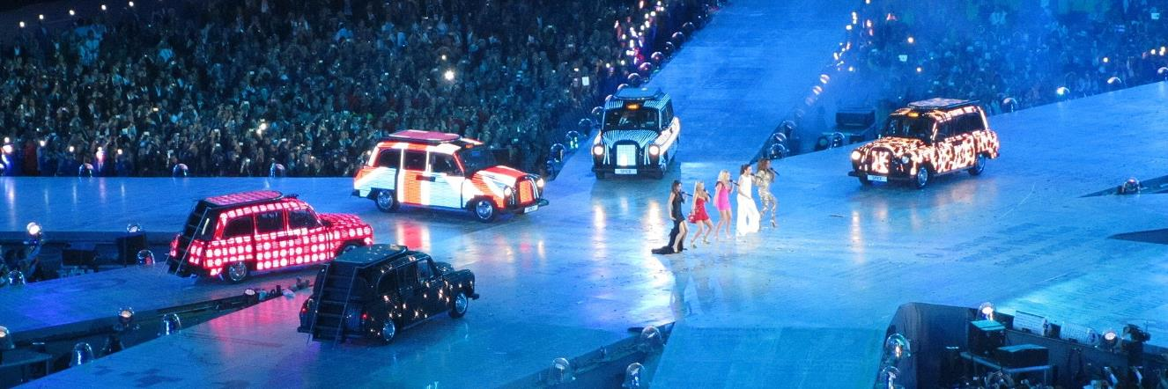
The Spice Girls
Did You Know that they became known for their saying, ‘Girl Power’
This meant that girls and women could do anything that they wanted.
They later released a book called ‘Girl Power’.
Original Name: Before they were the Spice Girls, the band was originally named "Touch".
The Nicknames:
Scary (Mel B)
Baby (Emma Bunton)
Sporty (Mel C)
Posh (Victoria Beckham)
Ginger (Geri Halliwell)
These were given to the girls by Top of the Pops Magazine in 1996 and quickly stuck
The band performed at the closing ceremony of the London 2012 Olympic Games. They performed on the top of a taxi which each of them entered the stadium on.

Slide 3
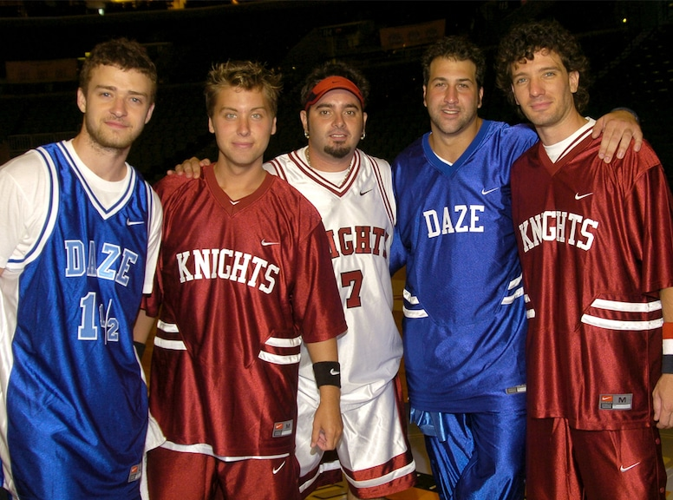
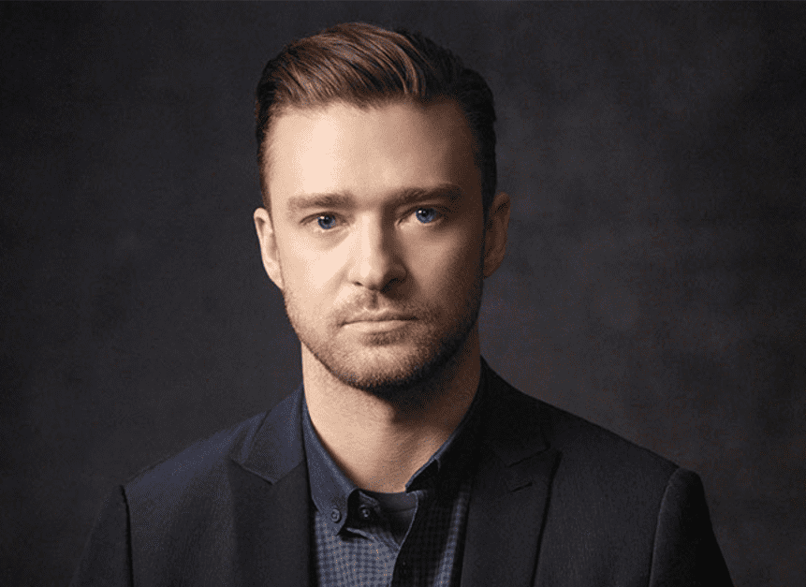
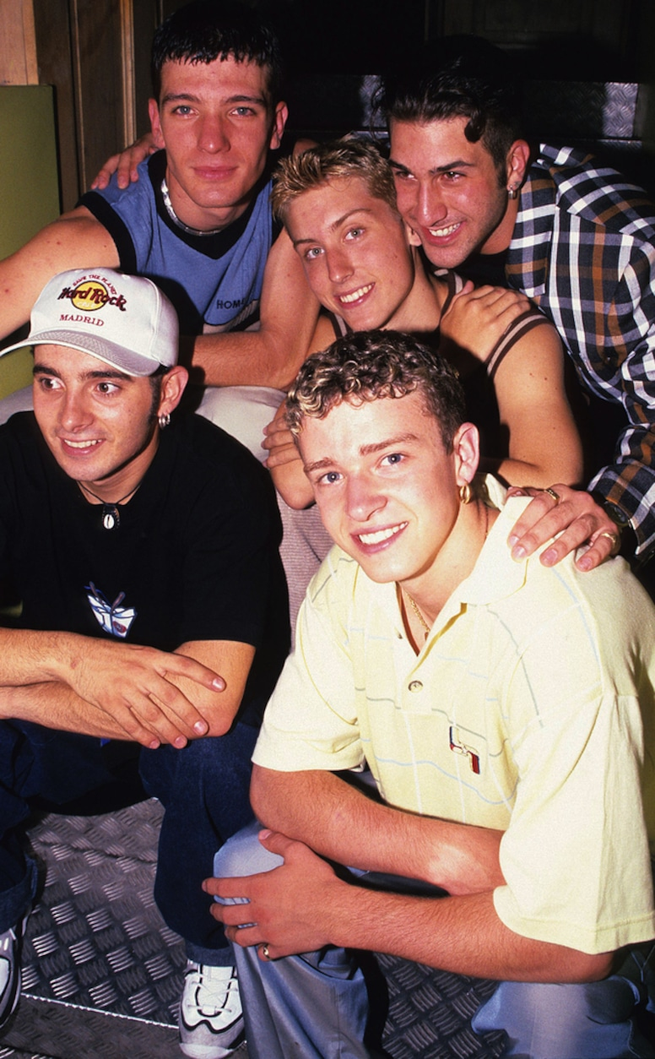
NYSNC
They formed in Orlando Florida in 1995.
The group had five members:
Lance Bass
JC Chasez
Joey Fatone
Chris Kirkpatrick
Justin Timberlake
NSYNC has sold over 70 million records worldwide, making them one of the best-selling boy bands of all time.
They famously held the record for the highest one-week album sales in US history for 15 years.
The band split up in 2002 after their Celebrity tour so they could all pursue their own careers.
Justin Timberlake was the only member who had a successful career after the band.

Slide 4
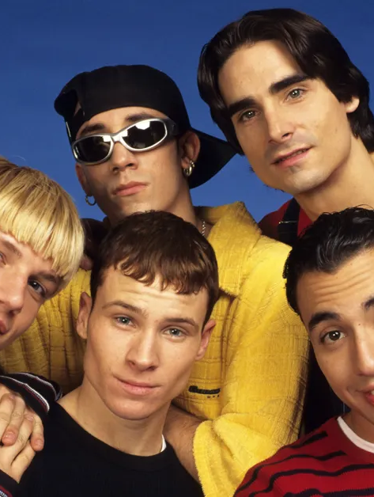
Backstreet Boys
The Backstreet Boys (BSB) are the highest-selling boy band of all time, with over 130 million records sold worldwide.
Formed in Orlando, Florida in April 1993, the group uniquely features the cousin duo of Kevin Richardson and Brian Littrell.
They are the only boy band to have their first ten albums reach the top 10 on the Billboard chart.

Slide 5
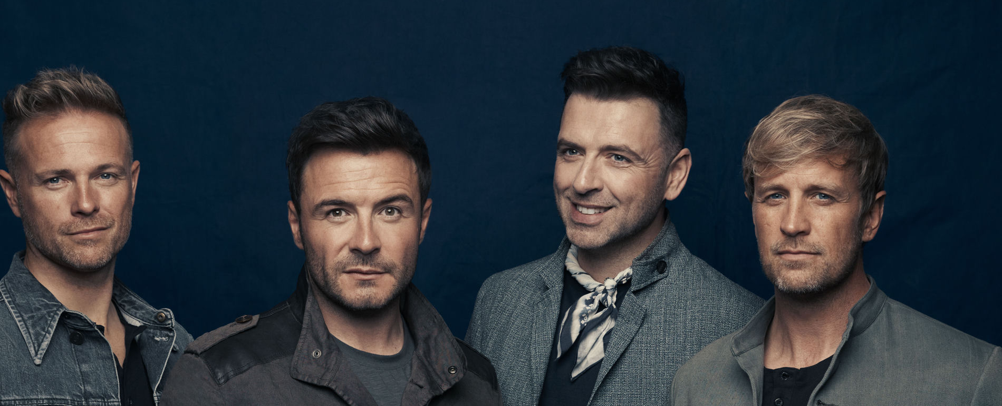
Westlife
Westlife is a highly successful Irish pop boy band formed in 1998.
They are best known for their soaring harmonies, 14 UK number-one singles, and massive international record sales.
They have sold over 55 million records and are one of the biggest-selling music groups in British and Irish history.

Slide 6

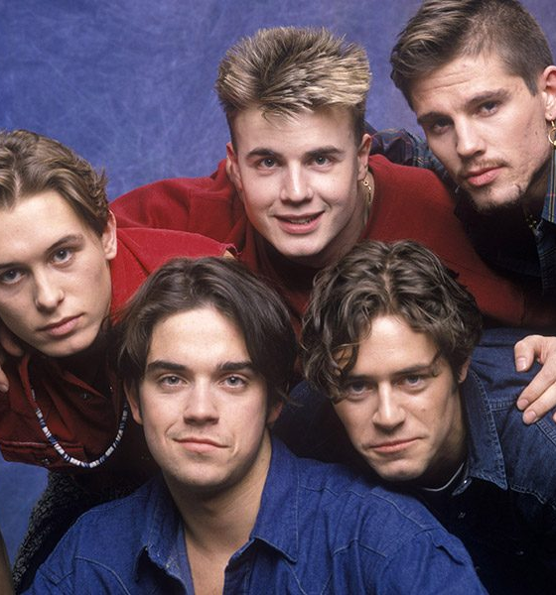
Take That
The group have had 28 top-40 singles, 20 top-10 and 17 top-5 singles on the UK singles chart.
Take That's original name was The Cutest Rush, made up of Gary Barlow and Mark Owen.
Then, when Robbie Williams, Howard Donald and Jason Orange joined the band, they called themselves Kick It for a while.
Of course, that didn't last long, and they changed their name to Take That and Party, before finally settling on Take That.
Take That have won a whopping eight BRIT Awards.

Slide 7
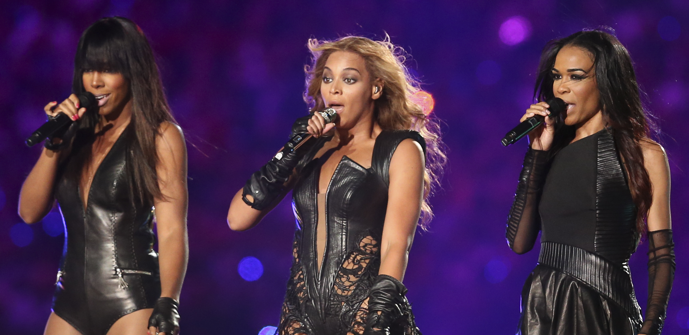
Destiny’s Child
Destiny’s Child was a legendary American R&B and pop girl group. Formed in Houston, Texas in 1990, the group achieved massive global success, becoming one of the best-selling female groups of all time. Their final and most famous lineup consisted of Beyoncé, Kelly Rowland, and Michelle Williams.
Original Name: Before they were named Destiny's Child, the group performed as "Girl's Tyme" and even competed on the television show Star Search in 1993.
The Name Origin: The name Destiny's Child was inspired by a passage in the biblical Book of Isaiah, chosen by Beyoncé's mother, Tina Knowles.

Slide 8
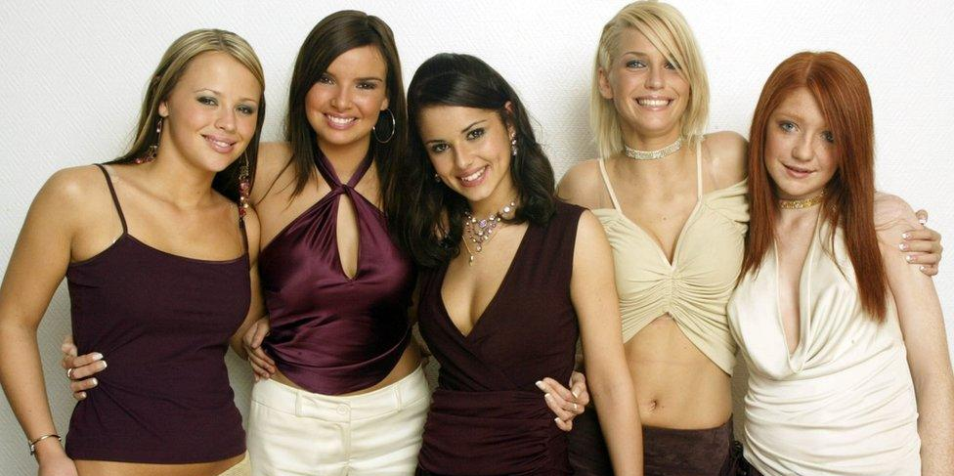
Girls Aloud
Girls Aloud are a highly successful British-Irish pop group formed in 2002 on the ITV show Popstars: The Rivals.
They hold a Guinness World Record for achieving 20 consecutive UK Top 10 singles.
The lineup consisted of Cheryl, Nadine Coyle, Sarah Harding, Nicola Roberts, and Kimberley Walsh.

