Slide 1
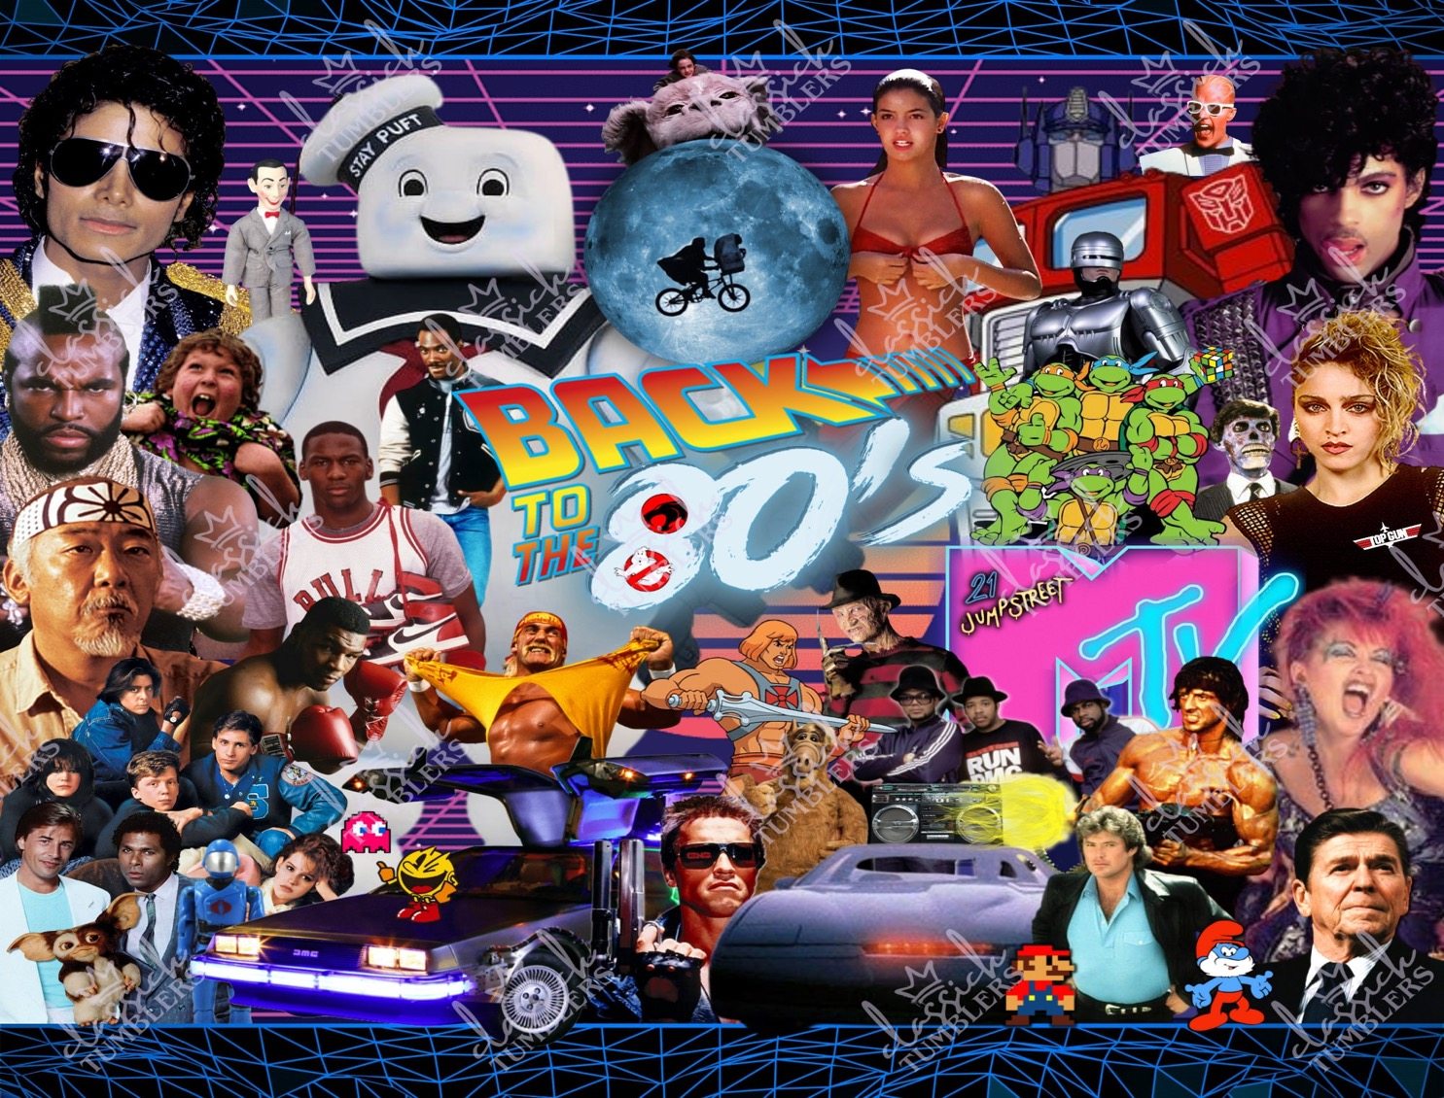
1980s
Artist / Band | Week Beginning
Toto | 13.04.26.
Wham | 20.04.26.
Bon Jovi | 27.04.26.
Duran Duran | 04.05.26.
Cyndi Lauper | 11.05.26.
Phil Collins | 18.05.26.
Term 3.1.

Slide 2
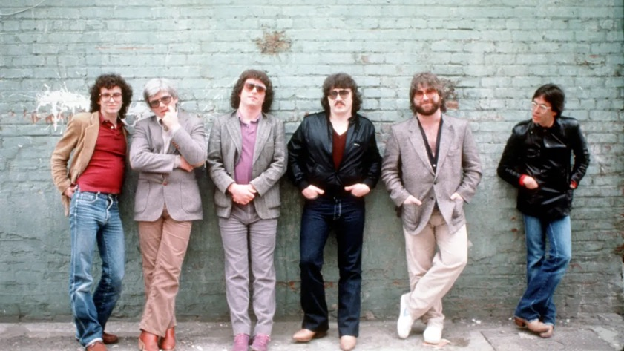
Toto
Toto is an American rock band formed in Los Angeles, California, America in 1977.
Toto combines elements of Pop, Rock, Soul, Funk, R & B, Blues and Jazz.
Having released 14 studio albums and sold over 40 million records worldwide, the group has received several Grammy Awards and they were inducted into the Musicians Hall of Fame in 2009.
Over the year they have had 13 different band members and they have 7 currently.

Slide 3
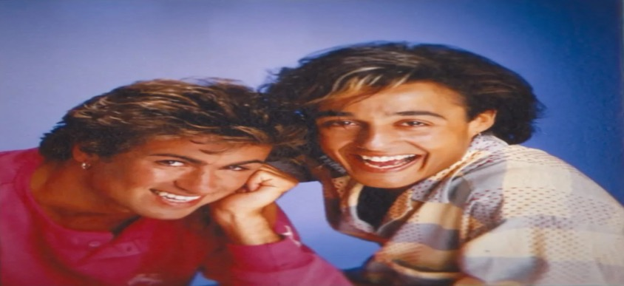
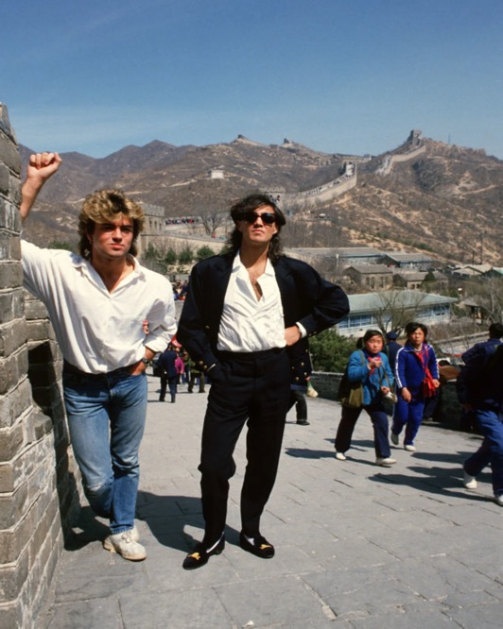
Wham
Wham was George Michaels and Andrew Ridgeley.
They met each other when they were 11 years old.
In April 1985, Wham! played shows in Beijing and Guangzhou, China, and in doing so, they became the first western pop act to perform in China.
On June 28, 1986, Wham! played a farewell concert at London’s Wembley Stadium that drew 72,000.
George Michael went on to have a very successful solo career after Wham.

Slide 4
Formed in Sayreville, New Jersey, in 1983, Bon Jovi is an American rock band known for bridging hard rock and pop, selling over 130 million albums worldwide
The band achieved global superstardom with their 1986 album Slippery When Wet and were inducted into the Rock and Roll Hall of Fame in 2018.
Over 40 years they have 120M album sales and performed 2700 concerts.
The lead singer, Jon Bon Jovi, went on to have a very successful solo career after Wham.

Slide 5
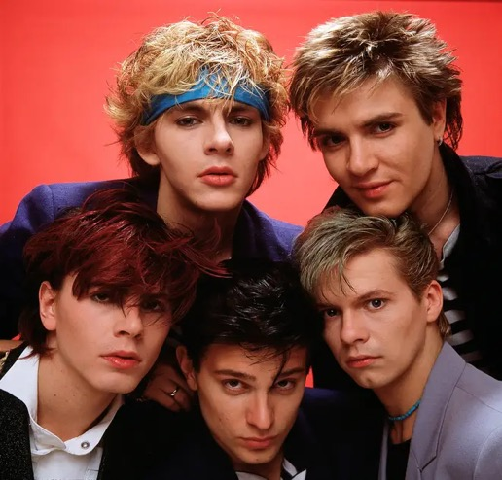
Duran Duran
Duran Duran are a famous English Pop band that formed in Birmingham in 1978.
In the 1980s, Duran Duran became one of the most successful bands in the world.
They were part of a music movement called the New Romantic scene, known for its stylish fashion.
Duran Duran has sold over 100 million records. They have won many awards, including two Grammy Awards and two Brit Awards. In 2022, the band was inducted into the Rock and Roll Hall of Fame.

Slide 6
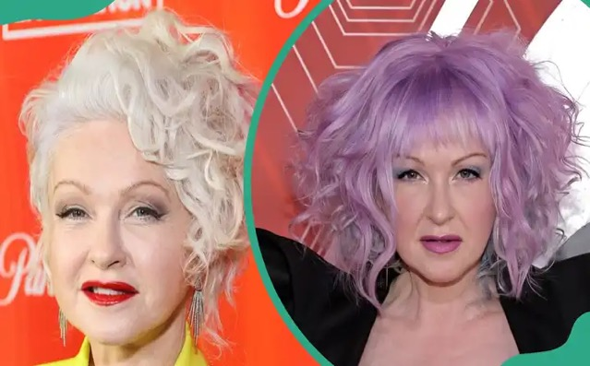
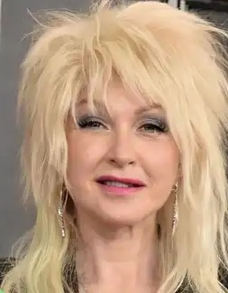
Cyndi
Lauper
Cynthia Ann Stephanie Lauper (born June 22nd, 1953) is an American singer, songwriter, and actress.
She is known as the ‘Queen of Quirky Pop’.
She is famous for her powerful voice, colourful hair, and unique fashion style.
Lauper has written 11 albums and sold over 50 million records around the world.
She is also known for her work to help others, especially in supporting equal rights for all people.

Slide 7
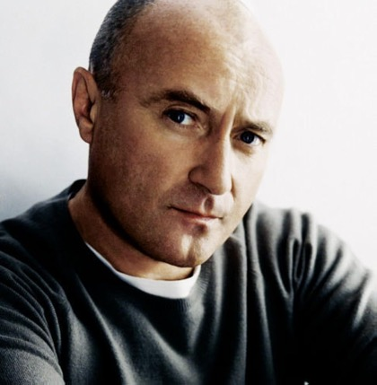
Phil Collins
Philip David Charles Collins (born 30 January 1951) is a famous English musician, songwriter, and actor.
He is best known as the drummer and later lead singer of the rock band Genesis.
Collins left Genesis in 1996 to focus on his solo work. He wrote songs for Disney's animated film Tarzan (1999). One of these songs, "You'll Be in My Heart", won him an Academy Award for Best Original Song.
Collins has sold an estimated 150 million records worldwide. This makes him one of the world's best-selling artists.

