Slide 1
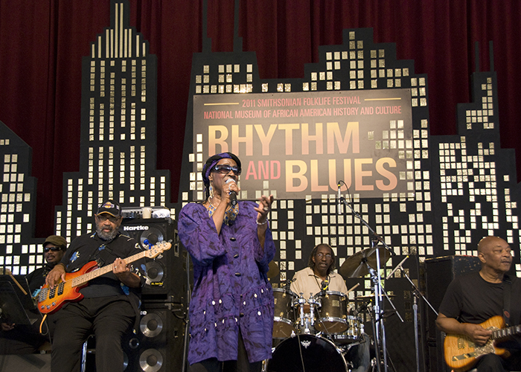
Rhythm & Blues
Artist / Band | Week Beginning
B B King | 23.02.26.
Stevie Ray Vaughan | 02.03.26.
Ray Charles | 09.03.26.
Nina Simone | 16.03.26.
Little Richard | 23.03.26.
Term 2.2.

Slide 2
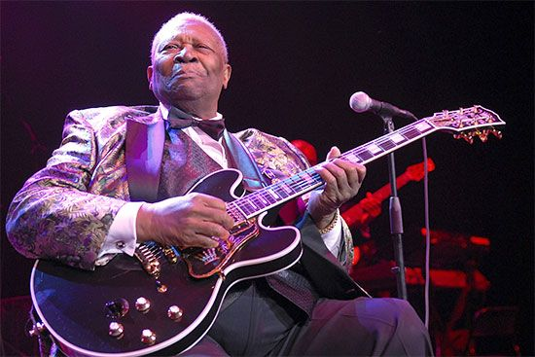
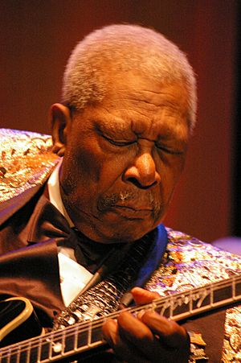
BB King
Known as the King of the Blues.
He named his guitar Lucille.
BB is short for ‘Blues Boy’.
He has won 15 Grammy Awards.
He has been inducted into the Rock and Roll Hall of Fame in 1987.

Slide 3
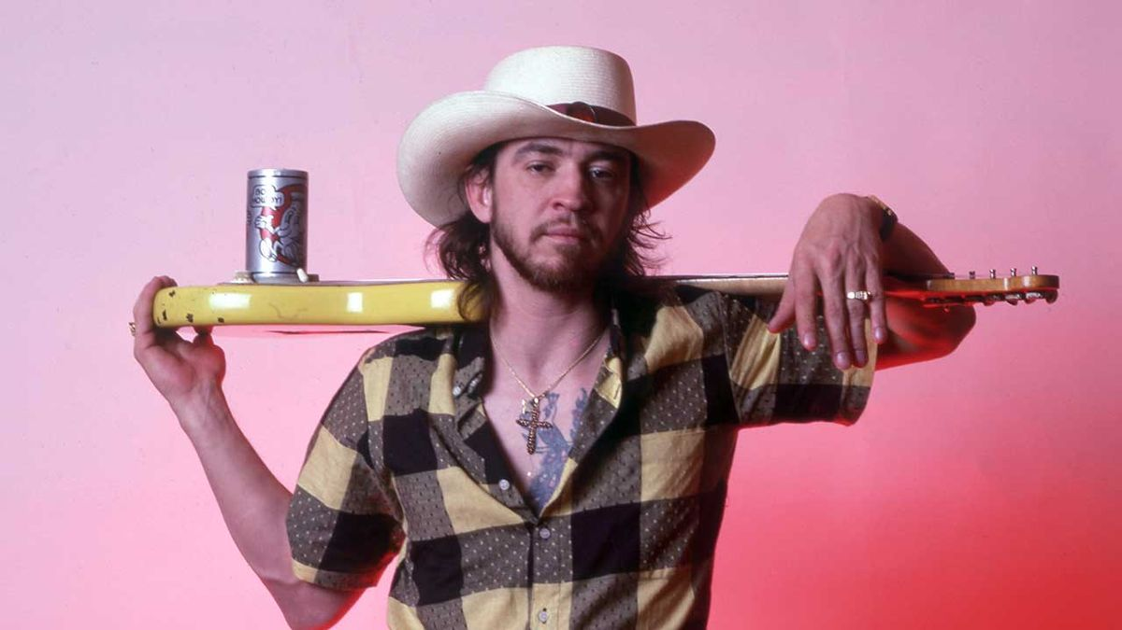
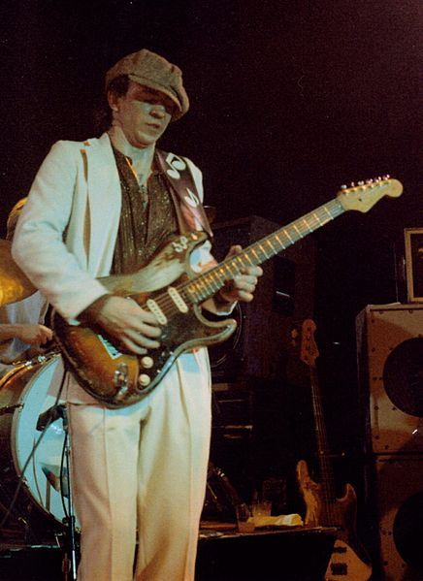
Stevie Ray Vaughan
He was a famous as the guitarist and leader of the blues rock band Stevie Ray Vaughan and Double Trouble.
He played the guitar solo on David Bowie’s song ‘Lets Dance’.
He wrote and performed the number one hit Crossfire.
He sadly passed away after a helicopter crash in 1990.

Slide 4
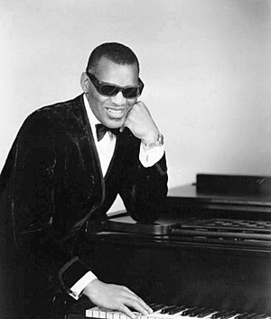
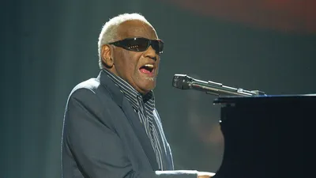
Ray
Charles
Ray Charles Robinson was called him "The Genius" because he was so talented and had a huge impact on music in the 20th century.
His friends often called him "Brother Ray."
Ray Charles lost his eyesight when he was a child, probably because of a condition called glaucoma, and he always wore his famous dark glasses.
He won 17 Grammy awards in his lifetime.
He has been inducted into the Rock and Roll Hall of Fame in 1986.

Slide 5
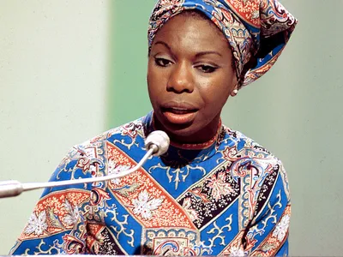
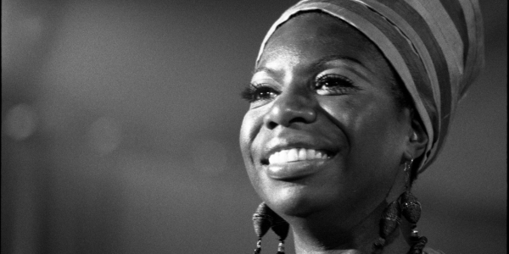
Nina Simone
Nina Simone was born Eunice Kathleen Waymon and she was an American singer, songwriter, and pianist.
She was also a composer, arranger, and an important civil rights activist. Her music mixed many styles, including classical, folk, jazz, blues, gospel, R 7 B and pop.
In 2023, Rolling Stone magazine named Simone one of the 200 Greatest Singers of All Time.
She recorded over 40 albums between 1958 and 1974

Slide 6
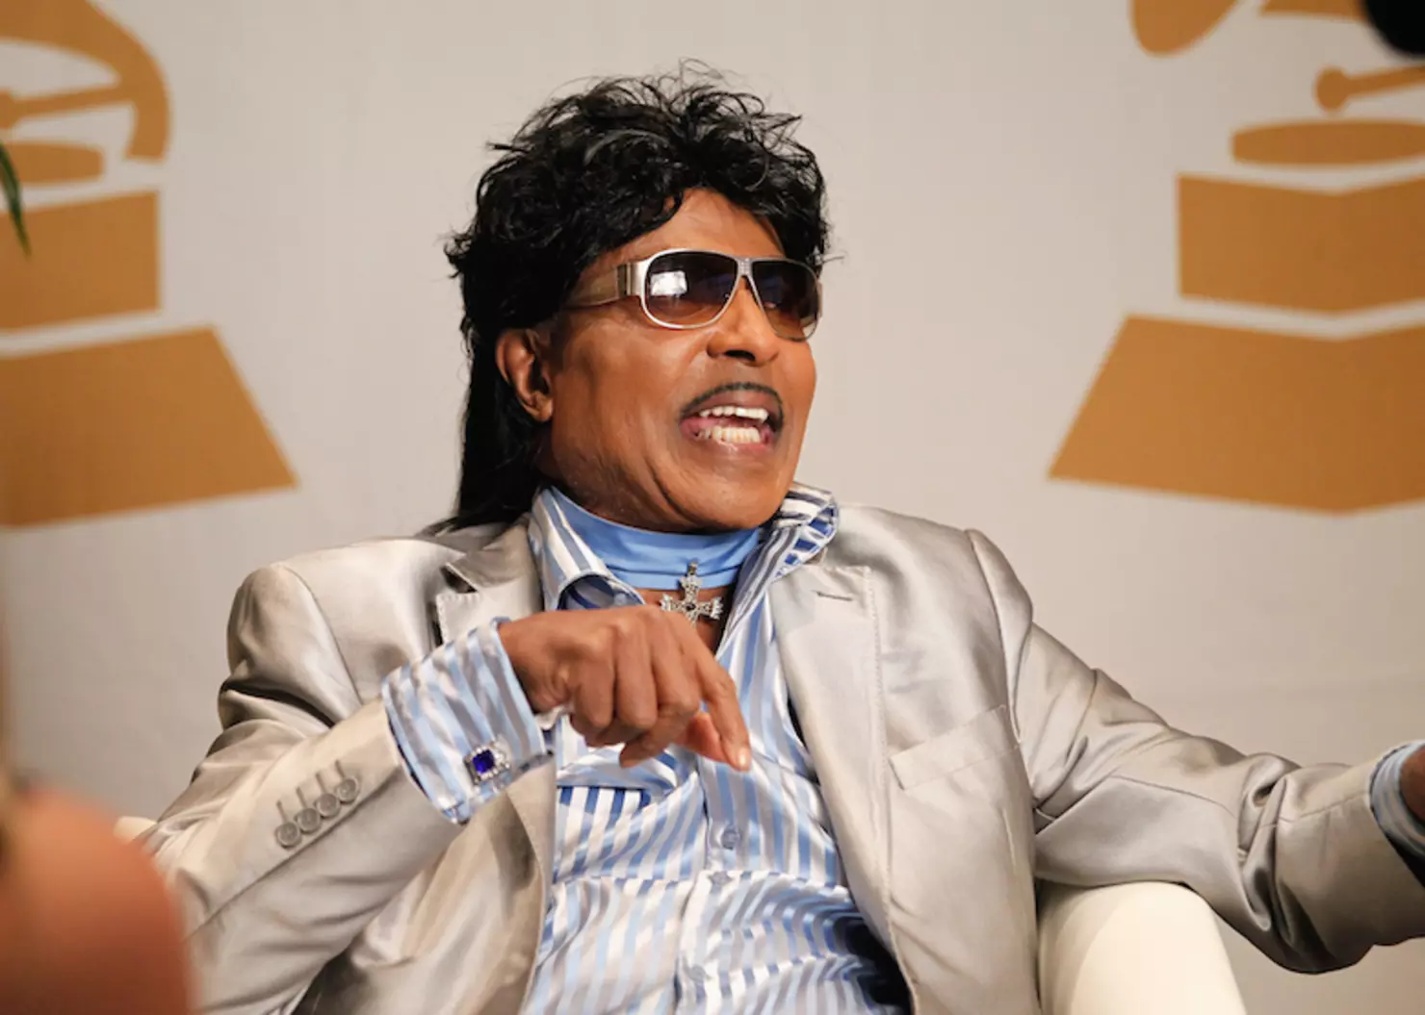
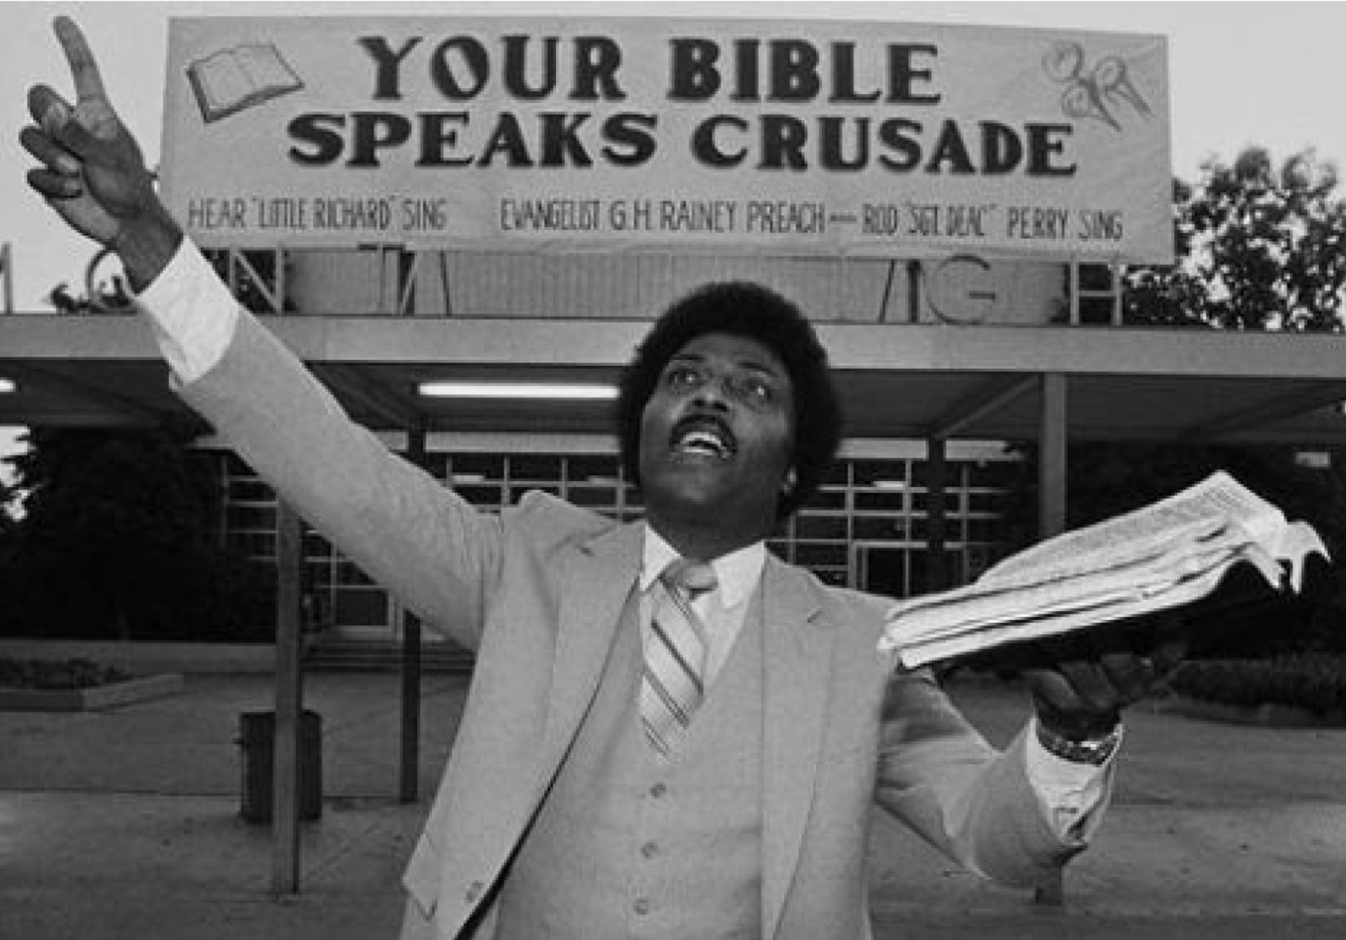
Little Richard
Little Richard (Richard Wayne) was a superstar pianist known as a founding father of Rock and Roll.
Famous for hits like "Tutti Frutti" and "Long Tall Sally," he brought high-energy and colourful fashion to music in the 1950s, breaking down racial barriers.
In 1957, when he was at the peak of his fame, Little Richard decided to stop playing rock and roll. He went to Bible college and became a church preacher. For many years, he only played Gospel music. Later in life, he returned to playing Rock and Roll.
He was one of the first people to be put into the Rock and Roll Hall of Fame in 1986. He was also added to the Songwriters Hall of Fame.

