Slide 1
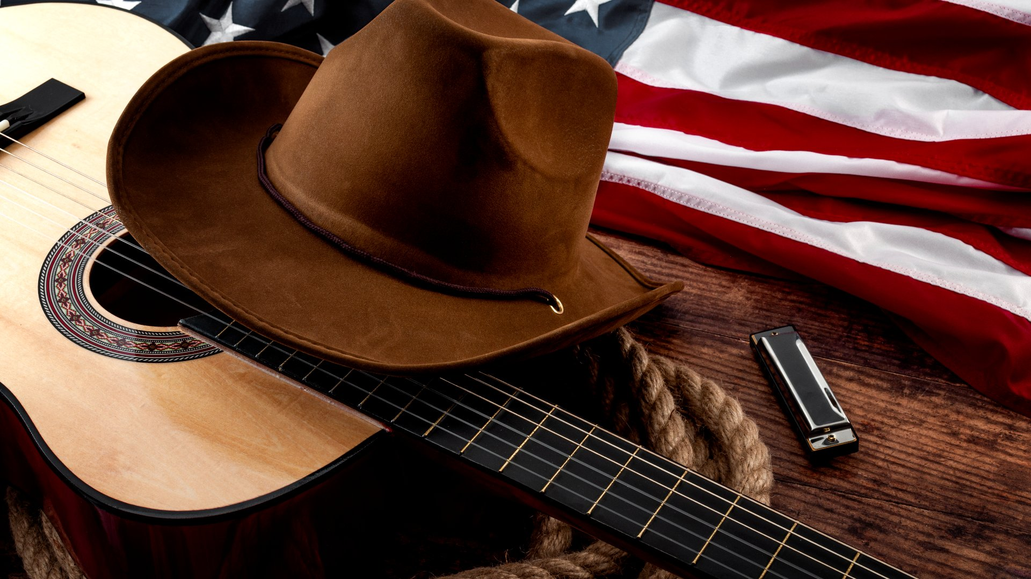
Country
Artist / Band | Week Beginning
Dolly Parton | 08.09.25.
Shania Twain | 15.09.25.
Chris Stapleton | 22.09.25.
Lainey Wilson | 29.09.25.
Jonny Cash | 06.10.25.
George Strait | 13.10.25.
WSLE Focus | 20.10.25.
Term 1.1.

Slide 2
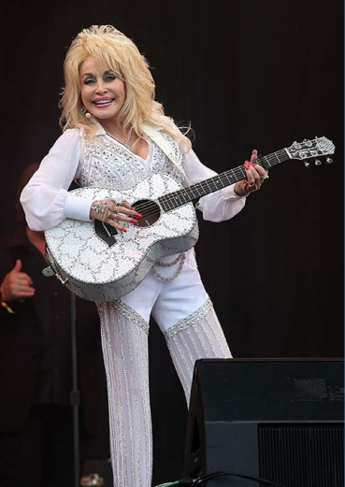
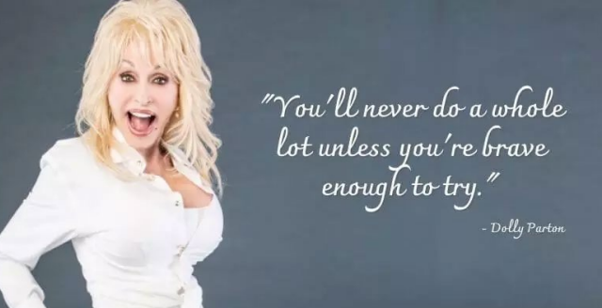
Dolly Parton
Dolly Parton is an American songwriter, singer, actress, author, businesswoman and humanitarian. Born in a poor part of Tennessee, Dolly was one of twelve children.
Dolly’s first solo performances were at church when she was only 6 years olds. Her uncle bought her a guitar when she was eight and by the age of 10 she was singing professionally on the radio.
Dolly is known as one of the best Country singers and composers of all time.
Because her father could not read, helping children to love and read books is very important to her. She has set up her own charity called Dolly Parton’s Imagination Library. This began in 1995 in Tennessee, where Dolly was born.
Dolly has written over 3,000 songs
She has 44 career Top 10 country albums, a record for any artist, and she has 110 career charted singles over the past 40 years.

Slide 3
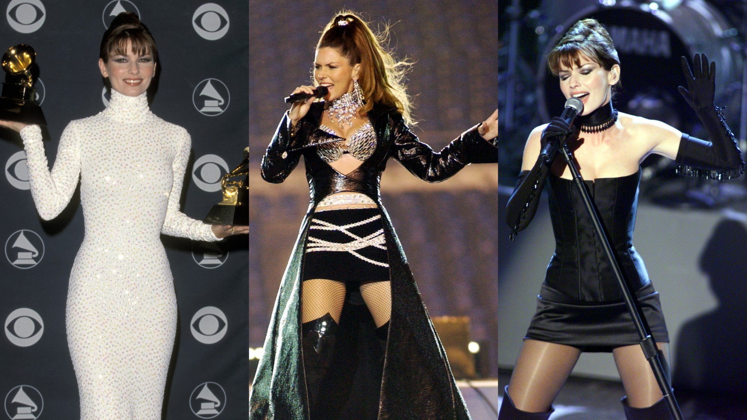
Shania Twain
Eilleen Regina "Shania" Twain is a famous Canadian singer and songwriter.
She was born on August 28, 1965.
Shania Twain has sold over 100 million records worldwide.
This makes her one of the best-selling music artists of all time.
She is also the best-selling female country music artist ever.
People often call her the "Queen of Country Pop". Billboard magazine recognized her as a top artist who blended country and pop music in the 1990s.

Slide 4
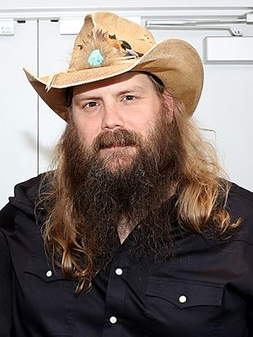
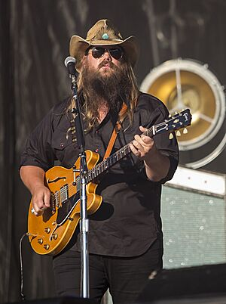
Chris Stapleton
Christopher Alvin Stapleton (born April 15, 1978) is an American country singer, songwriter, and guitarist who was born in Kentucky and moved to Nashville in 1996.
There, he started a music career instead of studying engineering. Soon after, he signed a deal with Sea Gayle Music to write and release his songs.
Chris Stapleton has written many hit songs for other artists and worked on albums for famous singers like Adele, Kelly Clarkson, and Taylor Swift.
Before becoming a solo artist, Stapleton sang in two bands. One was a bluegrass group called the SteelDrivers. The other was a rock band named the Jompson Brothers.
His first solo album, Traveller (2015), became very popular. It reached number one on the US Billboard 200 chart. His cover of "Tennessee Whiskey" also became a huge hit.
Stapleton has won many important awards. These include ten Grammy Awards, eleven Academy of Country Music (ACM) Awards, and fifteen Country Music Association (CMA) Awards. In 2019, he was named the ACM's Artist-Songwriter of the Decade. This means he was recognized as the best artist and songwriter of the past ten years.

Slide 5
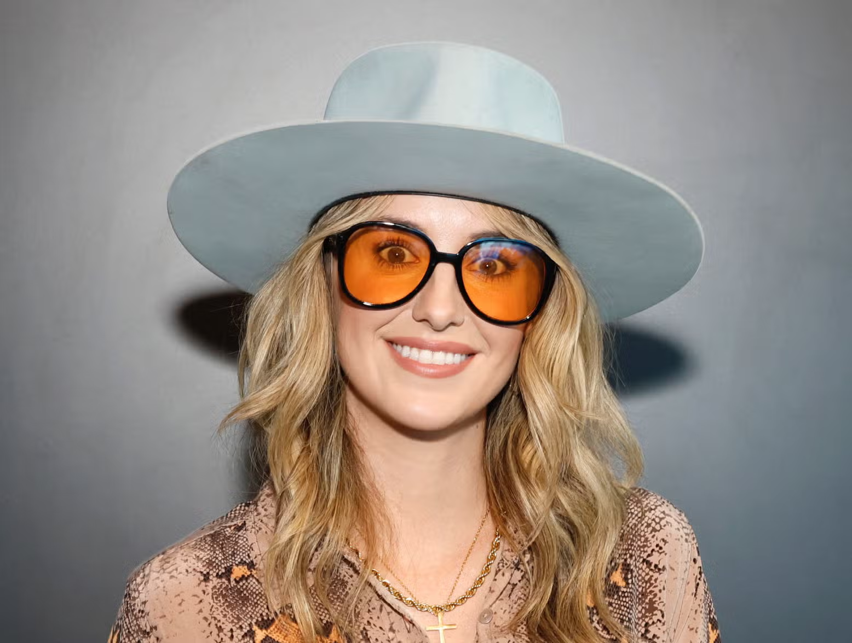
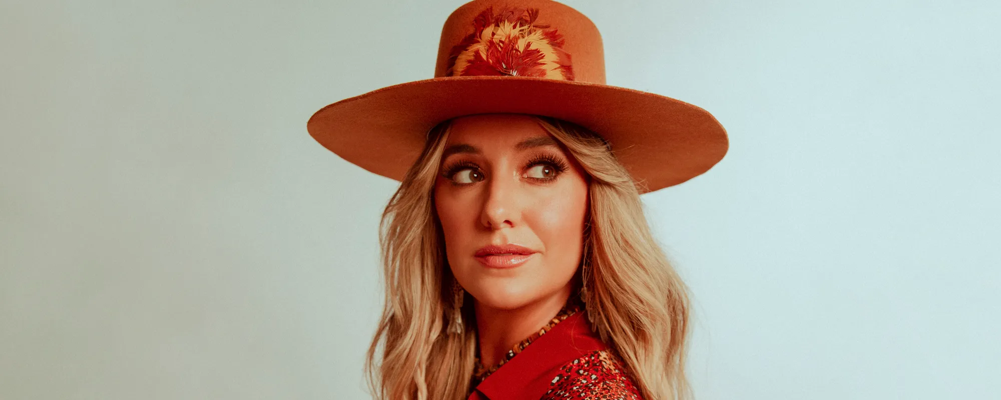
Lainey Wilson
Lainey Wilson is a country singer from Louisiana who started singing and writing songs at a young age.
She's known for her unique style and for staying true to her roots, even as she's become a successful artist.
She even performed as Hannah Montana at events in her early career.
Moved to Nashville: She moved to Nashville in 2011 to pursue her music career.
She admires Dolly Parton and even wrote a song called "WWDD" (What Would Dolly Do?).
She even had a role in the popular TV show "Yellowstone

Slide 6
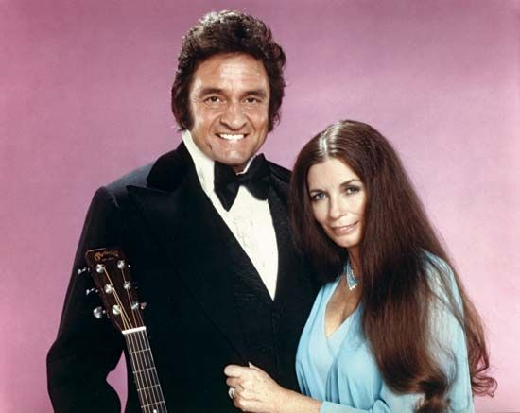
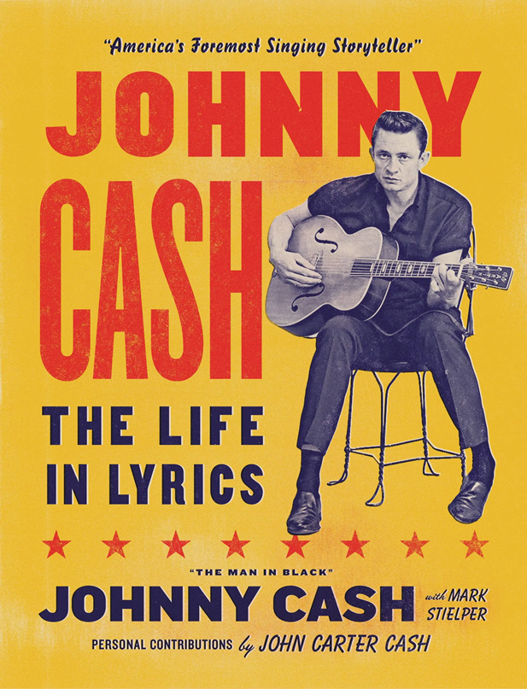
Jonny Cash
Jonny Cash was born in Kingsland, Arkansas, on February 26, 1932. His family was poor, and he had to work from a young age.
He was an American singer-songwriter who sparked a renewal of interest in country music with his simple, yet powerful songs.
Influenced by the southern musical tradition, Cash learned to play the guitar and was writing and performing songs by the end of high school. He served in the U.S. Air Force and then in the mid-1950s settled in Memphis, Tennessee, where he formed a group, Johnny and the Tennessee Two, that got a recording contract in 1955.
In 1966 his concert in Liverpool, England, broke an attendance record set by a popular local band, the Beatles.

Slide 7
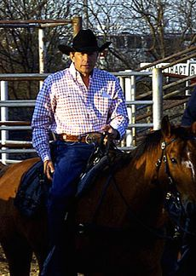
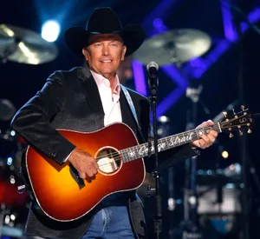
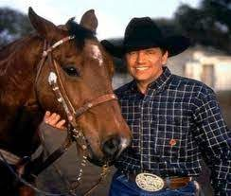
George Strait
George Strait is the 12th best-selling artist in American history.
He has sold 70 million records in the United States.
Since 2013, he has held the world record for most number-one hits across all charts and genres, with 60 songs.
He is also the only artist to have a top-10 hit every year for 30 years.

