Slide 1
Motown
Artist / Band | Week Beginning
Stevie Wonder | 21.04.25.
The Temptations | 28.04.25.
Jackson 5 | 05.05.25.
The Supremes | 12.05.25.
Marvin Gaye | 19.05.25.
Term 3.1.

Slide 2
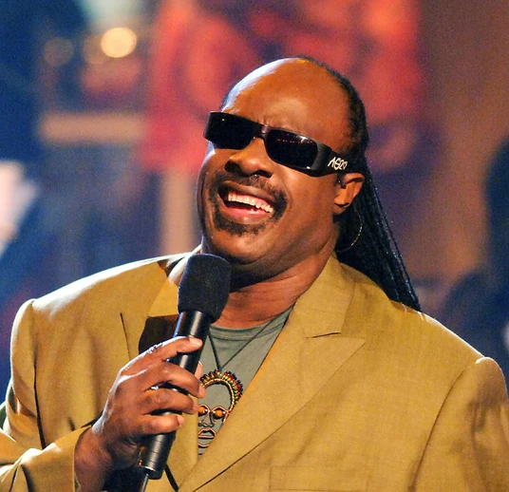
Stevie Wonder
Stevland Hardaway Morris was named Little Stevie Wonder as he was signed to Motown records at the age of 11.
He is an American singer-songwriter, who is credited as a pioneer and influence by musicians across a range of genres that include rhythm and blues, pop, soul, gospel, funk and jazz.
He has been blind since shortly after his birth.
Wonder is one of the best-selling music artists of all time, with sales of over 100 million records worldwide.
He has won 25 Grammy Awards (the most by a solo artist) and one Academy Award (Best Original Song, for the film The Woman in Red).
He has 9 children.

Slide 3
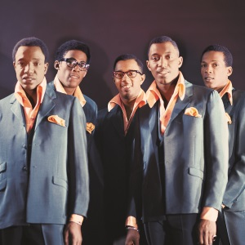
The Temptations
The Temptations are an American vocal group who released a series of successful singles and albums with Motown Records during the 1960s and 1970s
Over the course of their career, the Temptations released 4 Billboard Hot 100 number one singles and 14 R & B number-one singles.
Their music has earned 3 Grammy Awards.
The Temptations were the first Motown recording act to win a Grammy Award – for "Cloud Nine" in 1969.
In 2013 received the Grammy Lifetime Achievement Award.

Slide 4
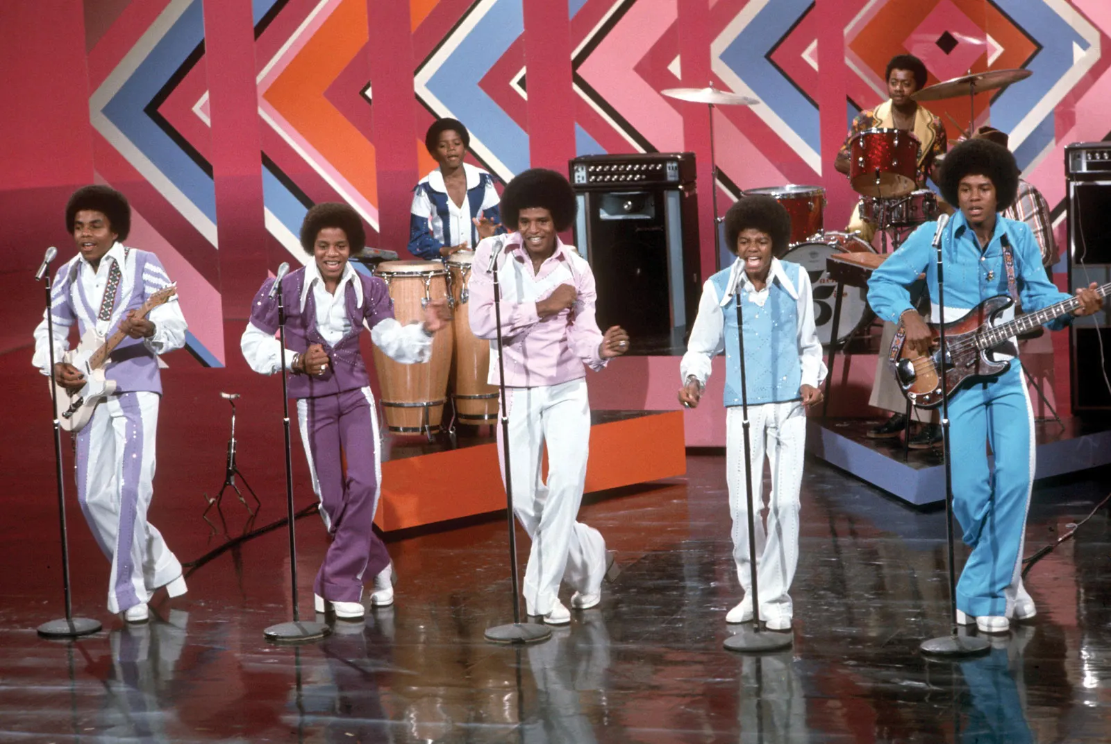
The Jackson 5
The Jackson 5 was an America musical group who played R & B, Soul, Pop and Disco.
The group was made up of the Jackson brothers Michael, Jackie, Tito, Jermaine & Marlon.
Michael was the lead singer.

Slide 5
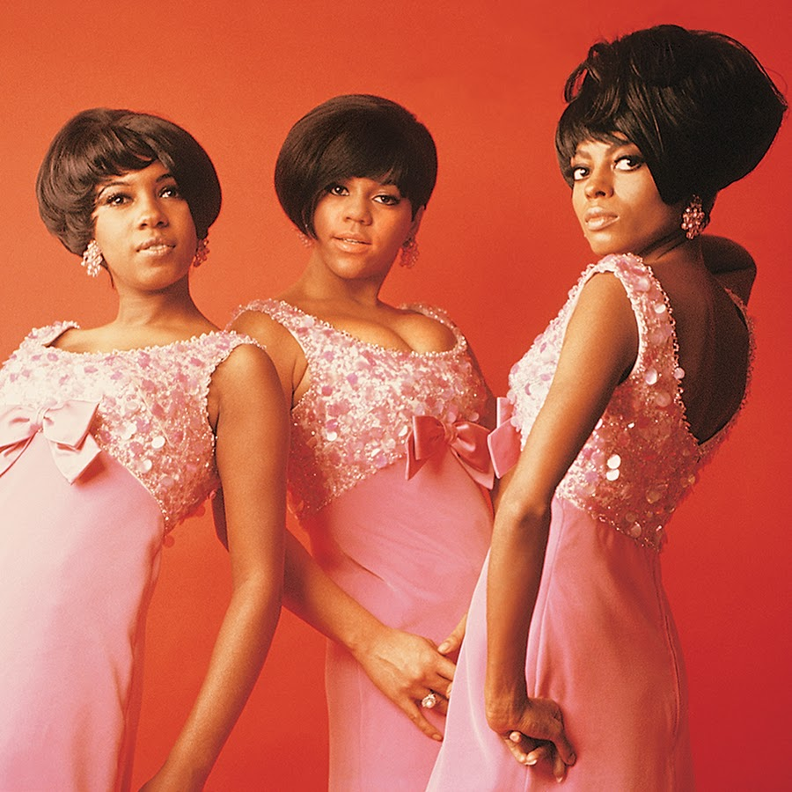
The Supremes
The Supremes were an American female singing group.
They were called the The Primettes when they started in Detroit Michigan.
The singers in the group were Diana Ross, Mary Wilson and Florence Ballard.
They recorded music for Motown records.
The Supremes' were known for their Doo-Wop, Pop, Soul and Disco.
The Supremes were the most commercially successful of Motown's acts. They are, to date, America's most successful vocal group, with 12 number 1 singles on the Billboard Hot 100.

Slide 6
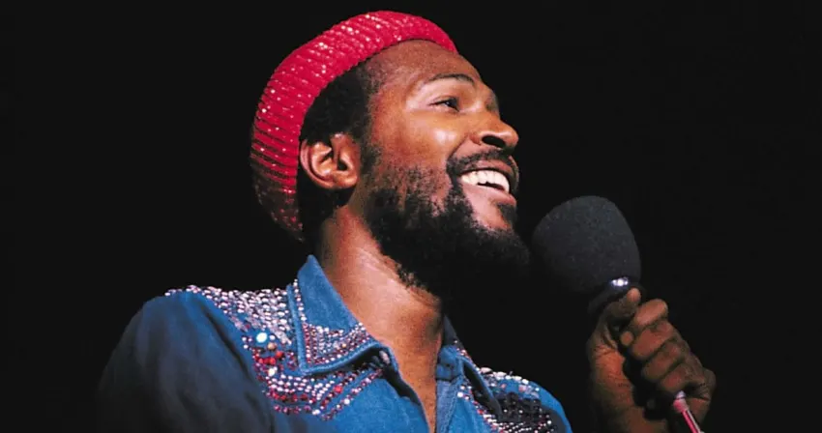
Marvin Gaye
Marvin Pentz Gaye (April 2, 1939 – April 1, 1984), was an American R & B and soul singer.
He helped to shape the sound of Motown in the 1960s, first as an in-house session player and later as a solo artist with a string of successes, earning him the nicknames "Prince of Motown" and "Prince of Soul".
Gaye's last televised appearances was at the 1983 NBA All-Star Game, where he sang "The Star-Spangled Banner” = American National Anthem.

